Slide 1
Convert E/R to Relation

Slide 2
Entity Set -> Relation
Relation: Beers(name, manf)
name
manf
Beers

Slide 3
Relationship -> Relation
name
addr
name
manf
Drinkers
Likes
Beers
husband
1
2
Favorite
Buddies
Likes(drinker, beer)
wife
Favorite(drinker, beer)
Married
Buddies(name1, name2)
Married(husband, wife)

Slide 4
Weak Entity Set -> Relation
name
name
Logins
At
Hosts
location
billTo
Hosts(name, location)
Logins(loginName, hostName, billTo)

Slide 5
Weak entity (continued)
Convert the following E/R diagram to relational schemas.
name
name
name
Host
Secondary
Domain
Primary
Domain
PrimaryDomain(name)
SecondaryDomain(secondaryDomainName, primaryDomainName)
Host(hostName, secondaryDomainName, primaryDomainName)

Slide 6
Exercise # 1
Construct an E/R diagram for a hospital with a set of patients and a set of physicians.
Associate with each patient a log of the various tests conducted, along with the date and time of the test.
Convert the E/R diagram into relational schemas.

Slide 7
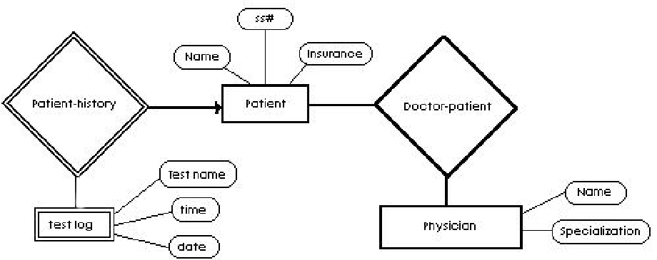
Physician( name, specialization)
Patient( ss#, name, insurance)
DoctorPatient( name, ss#)
TestLog( ss#, testName, testTime, date)

Slide 8
Combining Relations
It is OK to combine an entity set E with a relationship R if the multiplicity for the relationship is many-to-one, where E is the “many.”

Slide 9
Example – Combine Relations
name
addr
name
manf
Drinkers
Beers
Favorite
Drinkers(name, addr) and
Favorite(drinker, beer)
can be combined to:
Drinkers(name, addr, favBeer)

Slide 10
Exercise # 2
Draw an E/R diagram for the following:
Manufacturers have an unique name, an address, and a phone.
Products have a model number and a type (e.g. "TV set"). Each product is made by one manufacture, and different manufacturers may have different products with the same model number. However, you may assume that no manufacturer would have 2 products with the same model number.
Customers are identified by their unique social security number.
An order has unique order number and a date. An order is placed by one customer. For each order, there are one or more products ordered, and there is a quantity for each product on the order.

Slide 11
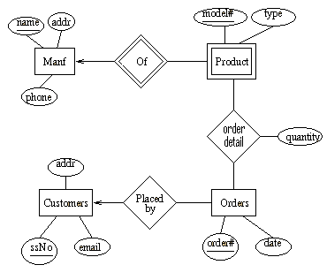
Solution # 3
Manf( name, addr, phone)
Product( name, model#, type)
OrderDetail( order#, name, model, quantity)
Customers( ssNo, addr, email)
Orders( order#, date , ssNo)

Slide 12
Question #3
Convert the Enrollment relationship in the following E/R diagram into entity set.
Convert the new E/R diagram into relational schemas.
name
number
description
Student
Enrollment
Course
id
GPA
address
credit
Grade

Slide 13
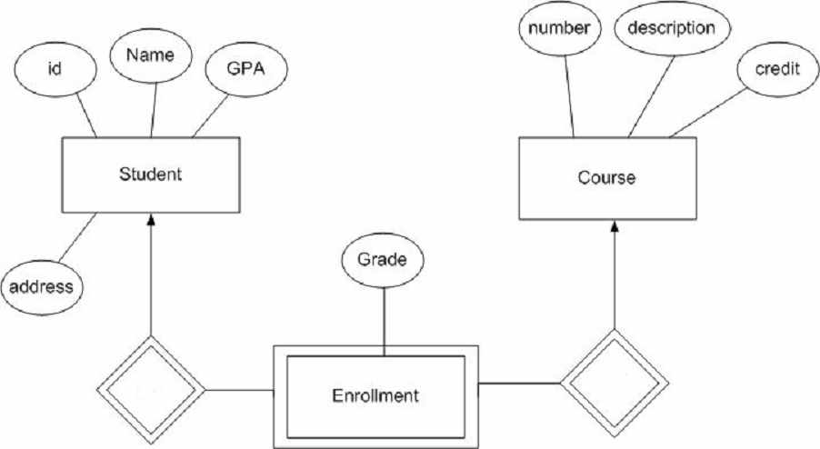
Student(id, Name, GPA, address)
Course(number, description, credit)
Enrollment(id, number, grade)

Slide 14
Subclass -> Relation
3 Approaches:
Straight E/R method
Object-Oriented method
Null method

Slide 15
Straight E/R Method
Straight E/R method
  One relation for each subclass
  Include:
    Key attribute(s) of parent
    Attributes of that subclass.

Slide 16
Example - Straight E/R Method
manf
name manf
Bud Anheuser-Busch
Summerbrew Pete’s
Beers
name color
Summerbrew dark
Ales
name
Beers
isa
Ales
color

Slide 17
Exercise #4 – Straight E/R
title
year
Movie
isa
isa
length
filmType
software
weapon
Cartoon
Murder-
Mystery
Movie(title, year, length, filmType)
Cartoon(title, year, software)
MurderMystery(title, year, weapon)

Slide 18
Object-Oriented Method
Object-Oriented method :
  One relation per subset of subclasses, with all relevant attributes

Slide 19
Example - OO Method
manf
name manf
Bud Anheuser-Busch
Beers
name manf color
Summerbrew Pete’s dark
Ales
name
Beers
isa
Ales
color

Slide 20
Exercise #5 – OO Method
title
year
Movie
isa
isa
length
filmType
software
weapon
Cartoon
Murder-
Mystery
Movie(title, year, length, filmType)
MovieCartoon(title, year, length, filmType, software)
MovieMurderMystery(title, year, length, filmType, weapon)
MovieCartoonMurderMyst(title, year, length, filmType, software, weapon)

Slide 21
Null Method
Null method :
  One relation
  Entities have NULL in attributes that don’t belong to them

Slide 22
Null Method
manf
name manf color
Bud Anheuser-Busch NULL
Summerbrew Pete’s dark
Beers
name
Beers
isa
Probably faster query execution (no joins), but uses more space if there are lots of attributes that are NULL.
Ales
color

Slide 23
Exercise #6 – NULL Method
title
year
Movie
isa
isa
length
filmType
software
weapon
Cartoon
Murder-
Mystery
Movie(title, year, length, filmType, software, weapon)

